Slide 1
U.C. Berkeley: Economics 115: Spring 2020
20th Century Economic History: Lecture 17: East Asia’s Rise
Brad DeLong
Department of Economics & Blum Center, U.C. Berkeley; & WCEG
delong@econ.berkeley.edu
last revised: 2020-04-20
for delivery: 2020-04-22
<https://bcourses.berkeley.edu/courses/1487684>
<https://github.com/braddelong/public-files/blob/master/econ-115-lecture-17.pptx>

Slide 2

East Asian Miracles
The Setting:
Asia on the “downside” of the Malthusian cycle when western Europe erupts into the eastern Pacific in the 1800s
Malthusian poverty means no middle class to demand domestic manufactures
Power gradient means no ability to impose tariffs
Lack of a powerful bourgeoisie means rule by princes for whom intensive economic growth is not a priority
“Confucian” religion means right orientation more important than rationalization of techniques and methods
As Melissas Dell says: if we were sitting here in the 1950s, we would not have predicted the East Asian Miracle:
South Korea was a basket case, with a highly corrupt government, that people assumed would be permanently dependent on foreign aid
The other Tigers weren’t faring much better
We would have likely guessed, if anything, that the Philippines would be the growth miracle:
It had the highest rates of education (primary, second, and tertiary) in Asia
It had the highest rates of indigenous entrepreneurship
And it had its health-care sector and other links with the US
36:00 minutes of audio
2:15
Notes:
East Asia was on the downside of the Malthusian cycle when western Europe erupted into the eastern Pacific in the 1800s: populous, with many ingenious and efficient non-machine technologies for squeezing output out of very limited resources, but desperately poor. “The West” brought machine technologies and the global market. It also brought a measure of contempt for east Asian civilizations. Nearly all western observers thought the idea that the Mysterious East might catch up to the north Atlantic in any reasonable historical timeframe was absolutely ludicrous.
Malthusian poverty meant no domestic middle-class to demand domestic manufactures, and productivity levels in Asia were hopeless as far as manufactured exports were concerned. The military and political power gradient vis-à-vis the north Atlantic meant no ability to impose tariffs, even had a domestic middle class on whose demand one might be able to build a community of engineering practice and progress existed. The lack of a powerful domestic bourgeoisie meant rule by princes for whom broad-based economic growth was simply not a priority. And in general a “Confucian” religious orientation meant that right orientation was more important than the rationalization of techniques and methods.
As Melissa Dale says: If we were sitting here in the 1950s, we would not have predicted anything like east Asia’s miracles.
Yet we have had four: first the early industrialization of Japan, then the extraordinary drive of Japan to global north status from 1950 to 1975, then the four east Asian tigers, and now coastal China.
All that surprises: As Melissa Dell says: As of 1950 the smart western money was that the Philippines was much more likely than even Japan to rapidly obtain global north status. The Philippines had the highest rates of education in Asia. The Philippines had the highest rates of indigenous entrepreneurship. In the Philippines head it's healthcare sector and other close economic links with America.

Slide 3
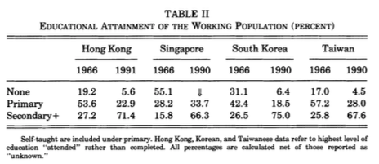
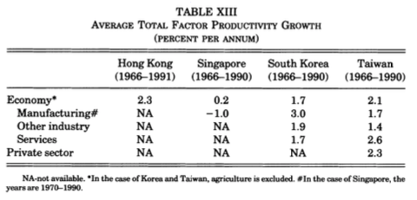
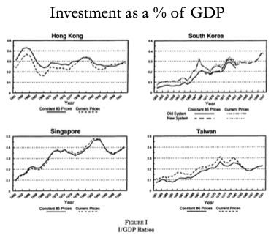
Proximate Causes of East Asian Miracles
Factor accumulation and technology transfer:
Factor accumulation
Highest savings rates in the world
Massive educational expansion
Rapid transfer from farm to city, and from agriculture to manufacturing
Where did demand for manufactured goods come from?
The Japanese state: rich country-strong army
The open world economy: neocolonial origins of comparative development
State capitalism with Chinese characteristics (and utopian socialist aspirations)
Yet also:
Getting institutions and incentives right
Success at technology transfer
Avoiding rent-seeking and other elite-corruption political economy traps
4:00
Notes:
What were the proximate causes of the east Asian miracles? Briefly, factor accumulation and technology transfer.
These economies grew in no small part through intensive factor accumulation: Education expanded massively. Their savings rates were the highest in the world. Hours worked were quite high. There was an extremely rapid transfer of workers from the farm to the city, and from low marginal value agriculture to constant and higher marginal value manufacturing.
Where did the demand for manufactured goods come from? Initially, in Meiji and post-Meiji Japan, from the state: The focus was on revering the emperor and expelling the barbarians, which required building a rich country that could build a strong army. The revenues of the aristocratic samurai class were confiscated by the state, and the samurai bought off by government bonds, the value of which was then inflated away. The government revenues were then used to fund the building of roads and factories. Later on, the growing Japanese middle class played a key role in demand.
After World War II—in Japan and in the four east Asian tigers—it was a combination of the opening world economy, and what Yingyi Qian and I call “neocolonial origins of comparative development”: It was very important for a United States fighting the Cold War that that part of east Asia that was in the “Free World” be prosperous and be seen to be prosperous. Thus export-oriented development strategies that would and did have run into nasty quota buzzsaws when pursued by Latin American and south Asian countries were welcomed when the exports came from east Asia. The United States was thus the importer of last resort for the east Asian development model.
This openness to exports channel was then amplified and reinforced by the Bush 41 and Clinton administration's decisions, even after the Tien an Men Square massacre, to hug China close: Generate as much contact as possible, economic, social, intellectual, and ideological, between the United States and the rising potential superpower across the ocean to the west. That seemed to provide the best road to a prosperous and peaceful 21st-century. That, after all had been Britain’s strategy over 1860-1945 with the then-rising potential superpower across the ocean to the west that was the United States. In Britain’s case, that strategy had been very successful.
Thus China's accession to the WTO and Chinese imports were greatly welcomed. Then came the decision of the Bush 43 government of the 2000s that its highest economic policy priority was a tax cut for the rich, funded by deficit spending and large-scale borrowing from China. That then carried with it the massive import flood of the China Shock, which was the real-side economy counterpart of the financial flows. That was the icing on the cake in making possible the coastal China growth miracle that has produced China’s state capitalism with Chinese characteristics (and utopian socialist aspirations).
Yet east Asian also managed the important tasks of: getting institutions and incentives right; succeeding at large-scale technology transfer; avoiding rent-seeking and other elite-corruption political economy traps.
Some people have argued that the large role played by factor mobilization makes the term “miracle” a misnomer. But that factor mobilization is a key is obvious. And lots of other places didn’t grow: were unable to do the factor accumulation. People need to have the right incentives to invest large shares of their incomes and to participate intensively in the labor force. That industrialization still hasn’t spread to many parts of the world suggests that creating and maintaining these incentives is no easy task.

Slide 4
Hypotheses?
A good hypothesis will have to fit with the Japanese and the coastal China miracles as well as with the “four tigers” experience:
Japanese colonial policy
Inequality
Industrial policy
Trade policy
Leaders matter (particularly in non-democracies)
State capacity: Peter Evans…
3:00
Notes:
What are the hypotheses for east Asia’s miracles? Remember: the geographical concentration of these economic miracles strongly suggests that saying “each country (and era) was different” will not cut it. There is something in the air, in the water, in the soil, found throughout east Asia that has made its economic experience very different from other places outside the global north. A good hypothesis will have to fit with the Japanese and the coastal China miracles as well as with the “four tigers” experience.
There have been a large number of explanatory hypotheses proposed:
* Japanese colonial policy—Japan is the seed from which all of the miracles grew, through its influence first on its colonial empire, and then through Taiwan’s influence on south costal China.
* The extraordinarily low level of inequality: Japan’s decapitation of its landlord samurai class meant that the poison of internal colonization by a hereditary landlord elite with all of its negative political economy consequences did not happen. Then Japan’s conquest of south Korea and Taiwan decapitated their landlord elites. Then the purge of Japanese collaborators did it again. Mao’s PLA did it in China. And so all east Asian economies have a social class that is (a) educated but (b) poor and propertyless, hence (c) interested in entrepreneurship and enterprise—in creative destruction and economic growth—rather than (d) in holding on to what they have and producing stagnation as a result.
* Neocolonial origins: any country could have done what east Asia did had they been allowed to craft smart tariffs to protect domestic industries in which they could build a community of engineering practice and acquire a comparative advantage, while at the same time having the freedom to export to the global north. But, outside of east Asia, the global north demanded that you pick one or the other: abandon domestic protection, even smart protection, if you wanted access to global north demand for manufactures.
* Simply that leaders matter: the Meiji reformers, those who rose to the top of Japanese politics after WWII, the brutal but effective Park Chung Hee and his successors, the KMT in Taiwan, and Deng Xiaoping and his successors, plus Lee Kuan Yoo were remarkable men whom east Asia was lucky to see.
* And, last, that east Asia somehow had the state capacity to run a developmental state: to have trade and industrial policy crafted to boost growth massively, as happened earlier with Germany and America’s “Hamiltonian system”, but to a much greater and more effective degreee.

Slide 5
State Capacity and Developmental States
Petr Evans: Embedded Autonomy:
Peter Evans (1995): Embedded Autonomy: States and Industrial Transformation, chapter 1 <https://delong.typepad.com/files/evans-embedded-i.pdf>
“Industrial policy” was a success in East Asia
A bad failure elsewhere.
Save Germany, and America, and Meiji Japan
Evans bets that to understand why, we need to focus on the state:
Melissa Dell calls out this passage: Evans:
“Until less hierarchical ways of avoiding a Hobbesian world are discovered, the state lies at the center of solutions to the problem of order...the contradiction between the ineradicable necessity of the state in contemporary social life and the grating imperfection with which states perform is a fundamental source of frustration. Dreams of cannibalizing bureaucrats are one response. Analyzing what makes some states more effective than others offers less immediate satisfaction but should be more useful in the long run
We need rules—for property, for exchange, for the provision of public goods
Attempts to dismantle the state risk perverse consequences: cf. communism
20th century states as key to different paths of historical development
3:30
Notes:
Let’s focus on state capacity and industrial policy
I was tempted—and I am sure Melissa Dell was tempted—to assign all of Peter Evans’s book Embedded Autonomy. It is great. But ars longa, vita brevis.
Evans starts with the observation that “Industrial policy” was a success in east Asia, and a bad failure elsewhere.
Actually, that is not quite true. We see premonitions of the east Asian post-WWII successful model in pre-WWI Germany, in Hamiltonian America, and in Meiji Japan.
Evans bets that to understand why, we need to focus on the state. Melissa Dell calls out this passage: Evans writes:
>“Until less hierarchical ways of avoiding a Hobbesian world are discovered, the state lies at the center of solutions to the problem of order... the contradiction between the ineradicable necessity of the state in contemporary social life and the grating imperfection with which states perform is a fundamental source of frustration. Dreams of cannibalizing bureaucrats are one response. Analyzing what makes some states more effective than others offers less immediate satisfaction but should be more useful in the long run…
Successful economies need rules—for property, for exchange, for the provision of public goods. Laissez faire will not cut it—too many externalities. That India was ruled by Britain under laissez-faire presumptions about policy for a century and yet in 1950 was as poor as it had been in 1850 should be enough to get anyone who holds that laissez-faire and laissez-faire alone is necessary, sufficient, and unique for successful economic growth laughed out of the room.
Attempts to dismantle the state risk perverse consequences: communist revolutionaries who fought to install a system that would make the state “wither away” ended up constructing extremely repressive states.
20th century states are a key to different paths of historical development. One of the few universals of the 20th century is the increasingly pervasive influence of the state. It is a necessary part of society and we should study how to make it better.
Key for quetions of economic development is how the state can succeed or fail at promoting industrial growth. Evan’s book looks at IT industries in three countries, Brazil, India, and Korea, during the 1970s and 1980s.

Slide 6
The State and Economic Order
Comparative advantage is dynamic:
Social and political institutions determine your niche
“Leading sectors” to move to a better niche
Powers
Limits
Not “how much” but “what kind” of state intervention
States on the continuum from predatory to developmental
Developmental states: taming elites via lowering risks of and creating incentives to engage in transformative investments
Evans seeks to trace lines from variation in state structure and state-society relations to variation in industrial policy outcomes
Predator states: let us look for a moment at the DRC…
3:30
Notes:
Consider the state and the international economic order.
Comparative advantage is dynamic: Comparative advantage is not just about natural endowments, but also about social and political institutions. State involvement is a determinant of what niche a country ends up occupying in the international division of labor. States with transformative aspirations are typically looking to participate in “leading sectors”. Efforts to reshape participation in the global economy are interesting because—while there are examples of success—they also often highlight the limits of what states can achieve.
A key argument in Evan’s book is that it’s more important to ask “what kind” of state involvement than to ask “how much”. India, Brazil, and Korea are very different contexts. Nevertheless, state involvement in industrial transformation in all three economies is undeniable.􏰀 These countries provide a stark illustration of why asking about the types of interventions undertaken is imperative.
At one pole, predatory states extract so much otherwise investable surplus—while providing so few public goods in return—that they impede economic transformation.
To sharpen ideas, let us look for the moment at the the archetypal predatory state: the DRC. Evans argues that “everything is for sale”; marketization and personalism dominate society-state relations rather than predictable, rule-governed bureaucratic behavior, which makes it foolhardy to make long-run investments.
The absence of bureaucracy is central to the DRC’s problems:
>”rule-governed behavior immersed in a larger structure of careers that creates commitment to corporate goals is notably in absence. The only semblance of corporate cohesion centers on the state’s repressive capacity, and even that teeters on incoherence…”
􏰀
The state works to actively disorganize civil society; it is not that the state has weak ties with civil society that prevent joint transformative projects, but rather that the state actively prevents the emergence of social groups that might have an interest in transformation, which would creatively destroy the power and the incomes of the rulers.
Developmental states foster long term entrepreneurial orientation amongst private elites by increasing incentives to engage in transformative investments and lowering risks. These states are not immune to cronyism and corruption, but on balance the consequences of their actions promote rather than impede transformation.
Evan’s goal is to link obvious variation in the outcomes of the state to underlying variations in state structures and state-society relations. He uses a comparative institutional approach.

Slide 7
Developmental States and Embedded Autonomy
Post-WWII Japan:
“Powerful, talented, and prestige-laden bureaucracy…"
Social network-based career strategies
Relative autonomy of the bureaucracy
Individual success springs from advancing societal goal: rich country—(once) strong army
Bureaucracy needs to be embedded in society—so that it understands it and help build it up—but autonomous—so that it is not under the control of parasitic hereditary elites—and mission-oriented
How is this different from Stalinist bureaucracy? Using rather than destroying the market; connecting rather than atomizing society
south Korea and post-WWII Taiwan
5:20
Notes:
Developmental states and embedded autonomy
Evans’s motivating example is the archetypal developmental state—Japan. Japan had a “powerful, talented, and prestige-laden bureaucracy.” Bureaucrats were selected by a competitive exam system, with only 2-3% of applicants succeeding.􏰀 The government officials’ success in building their careers takes place via conformity to bureaucratic rules rather than via exploitation of individual opportunities. But beyond impersonal bureaucracy, informal networks are integral to the state’s functioning. Japanese industrial policy depends fundamentally on the maze of ties that connect bureaucrats and industrialists: “Complex and stable ties with market players…”
Relative autonomy of the bureaucracy is what allows it to address the collective action problems of private capital. In the case of Japan historically, connectedness appears to create increased competence rather than state capture. Embedded autonomy: combines a Weberian bureaucracy with intense connections to the surrounding social structures. 􏰀Evans argues that embedded autonomy is the key feature of a developmental state.
Social network-based career strategies; the relative autonomy of the bureaucracy; individual success springs from advancing societal goal: rich country—(once) strong army.
The key is that the bureaucracy needs to be embedded in society—so that it understands it and helps build it up—but autonomous—so that it is not under the control of parasitic hereditary elites—and mission-oriented—in that all participants share a strong and ideology-driven commitment to achieving the societal goal of strong economic growth.
How is this different from Stalinist bureaucracy under really existing socialism? Using rather than destroying the market; connecting rather than atomizing society.
Two other examples are south Korea and Taiwan.􏰀 Korea: competitive exam-based civil service recruitment since 788 A.D.; the Japanese conquest then eliminated the bureaucrac’s allegiance to protecting and enhancing landlord interests because after the Japanese conquest there were no indigenous Korean landlords left; the system was weakened under Rhee—a patrimonial regime—but restored under Park. Economic Planning Board and chaebol. Relations to private sector less dense than in Japan—directed mostly towards chaebol—so a greater risk of unproductive rent seeking by a small number of firms.
􏰀
Taiwan: in mainland China, the KMT was largely predatory. In Taiwan, it remade itself. Less predatory, determined to conserve its bureaucratic capacity. But the state lacked dense relationships with the private sector. Still, the state provided a variety of supports and incentives. ISI not captured by the entrepreneurs that created it. Not a passive register of oligopoly interests.
Without autonomy, embeddedness produces state capture. Without embedness, an autonomous state wouldn’t know what needs to respond to, as embeddedness provides institutional channels for continual negotiation and renegotiation of goals and policies. Having successfully bound the behavior of incumbents to its pursuit of collective ends, the state can act with some independence in relation to particularistic societal pressures.

Slide 8
Developmental States and Embedded Autonomy II
Post-Deng Xiaoping China:
Deng Xiaoping had been a highly-competent Maoist cadre and fixer…
Great Leap Forward and subsequent famine pushed him over the edge…
But Mao returned in the Great Proletarian Cultural Revolution…
In the aftermath, CCP “let’s not do that again”
Deng as paramount, with a mandate to prevent future “cults of personality” and entrench collective leadership
“It does not matter whether a cat is black [red?] or white, what matters is whether it catches mice!”
And so began the path to China’s current system:
Socialism with Chinese characteristics?
Rectify names: state capitalism with Chinese characteristics and some utopian egalitarian aspirations
3:15
Notes:
Deng Xiaoping had been a highly competent Maoist cadre and fixer during World War II and afterwards in the Peoples Republic of China. The Great Leap Forward and the subsequent famine that took the lives of perhaps 50 million people—it may have been more, it may have been less, we really do not know and will never know, any more than we know how and why Mao’s chief comrade in arms and designated successor Lin Biao was assassinated in September 1971—caused him to swerve to a different path. Although he and Liu Shaoqi double-crossed the extremely brave Marshall Peng Dehuai when he challenged Mao at the Lu Mountain Communist Party general meeting, they did sideline Mao from effective power.
Mao, however, returned to effective power in the decade of chaos called the Great Proletarian Cultural Revolution, before losing strength and energy as he aged and died. No, we do not know how much of China's cultural heritage was destroyed. No, we do not know how many people died. In its aftermath, however, the Chinese Communist Party decided "let's not do that again". Dang was installed is paramount leader with a mandate to prevent future "cults of personality", entrench collective leadership, and finally get the economy developing again. The era between the communist victory in 1949 and the reenserfment of the peasantry with the herding of the rural population into communes in the mid-1950s had been a golden age for the living standards of typical Chinese. But it had been short. And there was very little difference between the typical Chinese standard of living in 1975 and what it had been in 1870.
Deng sought for policies that would work: “It does not matter whether a cat is black or white” he said, “what matters is whether it catches mice!” Or perhaps he said: “It does not matter whether a cat is red or white: what matters is whether it catches mice!” The second has an extremely sharp ideological edge: a “red” cat would be a revolutionary communist cat; a “white cat” would then be a counterrevolutionary bourgeois capitalist cat. But everyone hearing “black” understood that Deng was meaning “red”—meaning the very sharp ideological point that assertions of revolutionary ideological purity would no longer trump arguments about practicality—but saying so in a way that preserved plausible deniability that he was abandoning the communist for the capitalist road.
And so begins the path to China's current system: what was called "socialism with Chinese characteristics”. I strongly believe in the Confucian principle of the “rectification of names”: that we should call things what they are rather than what they are not. So I prefer to say: state capitalism with Chinese characteristics and some utopian egalitarian aspirations

Slide 9
The Post-Dengist Economy
Start by unwinding the communes:
Doubling rural standards of living
Gaining the regime enormous credit
Continue by hugging Taiwan’s entrepreneurial class close
Yingyi Qian (2001): How Reform Worked in China <https://delong.typepad.com/files/qian-reform.pdf>
Yingyi Qian: “transitional institutions”
Latecomers need to make special arrangements to compensate for their backwardness and they can find ways to do so
Cannot do global best-practice “first best”
And is the conventional wisdom as to what is “first best” always correct?
Chinese TIs unleashed the standard forces of incentives, hard budget constraints, and competition
Chinese Tis made reforms win-win even (especially?) for those in positions of bureaucratic power
2:00
Notes:
Deng started Chinese reform by unwinding the communes. That immediately doubled rural standards of living. That gained the regime enormous credit. He continued by hugging Taiwan's entrepreneurial class close—giving them the opportunity to enrich themselves by providing China as a whole with the nucleus of a bourgeoisie that those seeking to move into that social role could then emulate.
The regime then built with Yingyi Qian calls "transitional institutions”. They were not the economic institutions found in the global north: those were impossible for China to build in a day. Since China could not do the global “first best” in terms of what its institutional set up was, it had to find substitutes. As Alexander Gerschenkron had noted more than 3/4 of a century ago, that is often the case with successful latecomers to industrialization: they need to make special arrangements to compensate for their backwardness in institutions and economic developmenth.
Those that can find ways to do so are successful.
Those who cannot find ways to do so are not.
And, sometimes, the institutions they adopt raise the question: what is the conventional wisdom of what is "first best" accurate?
China's transitional institutions unleashed the standard forces of incentives, hard budget constraints, and competition to drive firms to efficiency in production and to taking advantage of opportunities by satisfying the shape of growing demand. China's transitional institutions also made reforms win-win rather than win lose: there was no disaffected group that saw itself as losing out. This was even (or was it especially?) true for those holding bureaucratic power, and for their close associates, current kin, and future descendants.

Slide 10
Chinese TIs
Five aspects:
“Dual track” approach: market prices at the margin, command-and-control underneath
TVEs—plus patronage
Fiscal federalism to make successful capitalist development a source of strength and resources for local governments
And so enhance bureaucrats’ future careers
“Anonymous banking”—allowing your new rich to hide their wealth from the government
FAILURE: SOEs: “no reforms of these SOEs have been found to improve economic efficiency and to make it interest compatible for those in power…”
But SOEs became a smaller and smaller part of the economy
3:45
Notes:
Yingyi Qian focuses on five aspects of Chinese transitional institutions:
1. The “dual track” approach: market prices at the margin, command-and-control underneath. Market prices at the margin provide the incentives in the budget constraints to make sure that the direction of economic growth is productive. That firms had to continue to make the deliveries and meet the requirements of the previous economic plan prevented the Chinese equivalent of the nomenklatura from doing what the Soviet nomenklatura had done: tunneling the state’s assets out of existing organizational forms into their own privately owned vehicles, and so creating a class of plutocrats and oligarchs that would undermine the legitimacy of the system massively.
2. The TVEs—plus patronage. That so many of the successful businesses started in the early stages we're township and village enterprises greatly assisted the success of reform. A TVE provided places in which clients and kin of party leaders and leading bureaucrats could be employed. The interconnection of growing private economic activity with the party via kinship and patronage links kept the party from seeing the nascent bourgeoisie as a competitor, and kept the nascent bourgeoisie from seeing the party as a foe. This alliance of interests was strengthened by the fact that private property was insecure. Indeed, private property in China is insecure today. Your business is your property only to the extent that you have powerful protectors in the bureaucracy and in the party who wish to make it so.
3. Fiscal federalism to make successful capitalist development a source of strength and resources for local governments, and so enhance bureaucrats’ future careers. Thus party leaders and leading bureaucrats had powerful reasons connected to their future promotion that the TVEs be successes and sources of funds for local governments, rather than just sources of cash to be drained and sources of employment for nephews, nieces, and clients.
4. “Anonymous banking”—allowing your new rich to hide their wealth from the government. With insecure property rights and with a bad history in its past, the communist party needed somehow to guarantee to the nascent bourgeoisie that its energy and effort would be rewarded. The communist party had to place the wealth gained somehow out of its reach.
5. There was one big institutional FAILURE: the SOEs. To quote Yingyi: “no reforms of these SOEs have been found to improve economic efficiency and to make it interest compatible for those in power…” It was feared that the inefficiency of the SOE's would bring the system down: the growing productive capitalist market economy would find itself staggering under the burden of taxation to keep the SOEs running, and so would itself stagnate, or collapse. But China grew so fast that that ceased to be a worry, as the SOEs became a smaller and smaller part of the economy.
State capitalism with Chinese characteristics and some utopian egalitarian aspirations. It worked. For forty years, ever since 1980, I have believed that the system faces deep problems caused by substantial flaws in the underpinnings it has in its second-best "transitional institutions". I have been expecting Chinese growth to slow down massively within the next decade or so. I have now been expecting this to happen for four decades. For at least the first three times that I expected this, I was wrong: it did not happen. We will see whether I am wrong or fourth time when 2030 roles around.

Slide 11
How Do We Think About the State’s Role Here?
Ideal Types:
(1) Regulator, (2) producer, (3) midwife, (4) gardener…
(3) & (4) work much better than (1) & (2), it seems…
(1) & (2) arise from negative conceptions of the private sector:
(1) State as regulator becomes preoccupied with policing rather than growing the private sector…
(2) State as producer: risky—bureaucratic imperatives of expansion even where inefficient, and levers of control allow it to do so…
(3) & (4) spring from greater optimism about the vitality of private capital:
(3) Midwife: infant-industry protection and encouragement. In the US, DARPA.
(4) Gardener: firms that need rather encouragement and assistance to advance the sector. But the existence of a directly interested private sector increases the risk for state capture, and thus crashing into rent seeking.
What are the rules? There are no rules! It depends!!
5:00
Notes:
How do we think about thet state’s role here? Some ideal types: Evans discusses the roles that developmental or intermediate states might play in fostering industrial transformation: 1. The state as regulator. 2. The state as producer. 3. The state as midwife: providing incentives for private enterprises to enter a new sector. 4. The state as gardener: after bringing entrepreneurial groups into a sector, the state further nurtures and promotes them. Central to Evan’s argument is that combinations of 3) and 4) tend to be more effective than combinations of 1) and 2).
Evans argues that the regulatory state and the producer state arise from negative conceptions of the private sector:
(1) State as regulator is most universal.􏰀 While regulation may be important, Evans argues that it is not particularly likely to promote economic transformation. Rather the state as regulator becomes preoccupied with policing.
(2) The state as producer. All states act as a producer of some goods—i.e. roads, the water supply, etc. Public goods produced by the state complement private investments. Some states go further, engaging in productive activities in ways that compete with or replace private producers.􏰀 There are some examples where state production is successful—i.e. steel in Korea—where there were no private enterprises likely to create this industry, which in turn had strong linkage effects to many other private industries.􏰀 However, the state as producer is a very risky strategy.􏰀 SOEs have an expansionary logic. Even if initially justified in a specific sector, they tend to expand to areas where they are not competitive.
Evans argues that the regulatory state and the producer state arise from negative conceptions of the private sector, and that greater optimism about the vitality of private capital leads to different roles:
(3) Instead of substituting itself for private entrepreneurs, the state could assist in the emergence of new entrepreneurial groups and encourage existing entrepreneurs to engage in more challenging endeavors. This idea was articulated decades ago by Hirschman. In the US, the role was perfomed par excellence by DARPA.
The role of midwife entails reducing the risk and uncertainty associated with entering a new sector or method of production. This could take the form of infant industry protection, providing subsidies and tax incentives, or inducing international capital to invest in a sector. This role can be more difficult if the transformation task is daunting or the existing entrepreneurial class is small.
(4) The state as gardener.􏰀 Once there are firms in a sector, they may need further encouragement and assistance to remain competitive as the sector advances.􏰀 Gardening could take the form of setting up incentives for firms to expand into technically challenging areas of the sector, or the state could take over riskier complementary tasks, like R&D, which are necessary for moving forward but may pay off only in the long-run.
Gardening is in some ways easier than midwifery because there are already private firms in the sector to work with. It is more demanding for the same reason: the existence of a directly interested private sector increases the risk for state capture.
Evans argues that the appropriate combination of these roles varies by the characteristics of an industrial sector. The prevalence of SOEs, for example, varies very widely. SOEs are common in steel and minerals—across a variety of countries—but rare in textiles. They are rarely successful in heavy metallurgy and mining. But states do not even try in textiles. States are most likely to be producers when entry barriers are high and when the technology is not closely held by a few global firms.
What are the rules? There are no rules! It depends!!

Slide 12
Is This All Just B-School Blather?
If you are like me, you may be suspicious at this point…
What is B-school blather? A combination of generalities, tautologies, and utopian demands…
Perhaps better to focus on what to avoid…
Abandon all hope of running a successful developmental-state industrial policy if:
You have landlords (or some other parasitic class interpenetrated with those from whose ranks your bureaucrats are drawn)
You do not have a shared ideology of economic development
You do not have the elite education and examination system you need
Government service is not respected
You cannot see the goal
You lack the factor-mobilization prerequisites
You lack the external market access
You lack the ability to judge success on the ground
In some ways, the best of all possible industrial policies is an undervalued currency, access to global markets and an ability to build infrastucture
But what to do once you have abandoned hope?
Neoliberal bet—low odds bet; counsel of despair…
Or try to build the preconditions for a developmental state…
5:45
Notes:
If you are like me, you may be suspicious at this point…: Is This All Just B-School Blather?
What is B-school blather? A combination of generalities, tautologies, and utopian demands. “Everything will work fine if you just do things right”. B school blather is someone pretending to speak with authority who actually has absolutely no clue as to how things work on the ground, or what one should do next, or what one should even do first, in order to accomplish the task. Embed your bureaucracy in the society, but still have it be autonomous? Have your bureaucracy be independent, and yet closely linked via social networks, education, and ideology to the other power brokers of society? This sounds a lot like: "just do it! And do it right!" In what conception of the world is this helpful?
I think we can put more meat on the bones here if we focus, instead, on what to avoid: Abandon all hope of running a successful developmental-state industrial policy if:
* You have landlords (or some other parasitic class interpenetrated with those from whose ranks your bureaucrats are drawn): then you are doomed, because the more effective your government’s ability to use levers of state power, the more the distribution of income and wealth will be frozen into a form pleasing to your anti-developmental current upper class. You need to start with a remarkably equal and definitely not inherited-inequality distribution of income and wealth. If you do not start there, abandon all hope.
* You do not have an ideology of economic development shared by your elite: if your elite judge each other by, say, how rich they get and do not judge each other by whether they have contributed to society’s growth mission, abandon all hope.
* You do not have an effective educational system for training and an effective examination system for selecting your bureaucrats. If your bureaucrats cannot outsmart the private sector and foreign managers whom they are attempting to regulate, outproduce, midwife, or garden, abandon all hope.
* You do not have an ideology in which government service is a high prestige occupation. If your best and your brightest do not regard government service as a good thing to do, abandon all hope.
* You do not have a firm and reality-based conception of what industrial structure you want your country to develop into. If you cannot point to another country, and say: we want to become like them, and here are the first stage investments and capabilities we need to develop to do so—if you cannot do that, abandon all hope.
* You do not have the factor-mobilization prerequisites—the power to mobilize savings for investment, to massively upgrade the technical education level of your population, to move people out of low productivity into high productivity occupations, to build the infrastructure and the links to global value chains. If you do not have the factor mobilization prerequisites to make a success of industrial policy, abandon all hope.
* You do not have access to the markets that will buy at a price that will cover your costs the goods you produce if your industrial policy is successful. If world markets are not open to you and you have to rely on domestic demand from a poor population, abandon all hope.
* You do not have the power to judge which private businesses are successful and need to be fertilized, and which are unsuccessful and need to be pruned back. The best way to do this is to lower the value of your currency and then watch which of your firms are successful exporters—to use foreign countries markets’ as devices for telling you who is making high-quality goods at a reasonable price. But you have to do this somehow. If you cannot measure where you are succeeding, abandon all hope.
With respect to this last, in some ways the best of all possible industrial policies is an undervalued currency, access to global markets, and an ability to build infrastucture.
But what to do once you have abandoned hope? Then, if you cannot run a developmental state, your only hope is the neoliberal bet—shrink the state and integrate into the global economy. It is a low odds bet; it is counsel of despair. But there is little as destructive as state-led development led by an anti-developmental state.
Or you could try the long, hard, difficult task of building the preconditions for a developmental state…

Slide 13
Readings
Key readings:
Peter Evans (1995): Embedded Autonomy: States and Industrial Transformation, chapter 1 <https://delong.typepad.com/files/evans-embedded-i.pdf>
Yingyi Qian (2001): How Reform Worked in China <https://delong.typepad.com/files/qian-reform.pdf>
Robert C. Allen et al. (2011): Wages, Prices, and Living Standards in China, 1738–1925: in Comparison with Europe, Japan, and India, Economic History Review 64 (2011): 8-38 <https://delong.typepad.com/allen_wpls_china.pdf>
Chiu Yu Ko, Mark Koyama, and Tuan‐Hwee Sng (2018): Unified China and Divided Europe, International Economic Review 59,1 (2018): 285-327 <https://delong.typepad.com/unified-china.pdf>
Tuan-Hwee Sng and Chiaki Moriguchi (2014): Asia’s Little Divergence: State Capacity in China and Japan before 1850, Journal of Economic Growth 19,4 (2014): 439-470 <https://delong.typepad.com/asia-divergence.pdf>

Slide 14
Wages, Prices, and Living Standards in China, 1738–1925
Robert C. Allen et al. (2011): Wages, Prices, and Living Standards in China, 1738–1925: in Comparison with Europe, Japan, and India, Economic History Review 64 (2011): 8-38 <https://delong.typepad.com/allen_wpls_china.pdf>:
In the eighteenth century, the real income of building workers in Asia was similar to that of workers in the backward parts of Europe but far behind that in the leading economies in north-western Europe. Real wages stagnated in China in the eighteenth and early nineteenth centuries and rose slowly in the late nineteenth and early twentieth, with little cumulative change for 200 years. The income disparities of the early twentieth century were due to long-run stagnation in China combined with industrialization in Japan and Europe…

Slide 15
Wages, Prices, and Living Standards in China
Robert C. Allen et al. (2011): Wages, Prices, and Living Standards in China <https://delong.typepad.com/allen_wpls_china.pdf>:
Expects “normal” politics:
Overthrow of entrenched hierarchies that hold back prosperity in the interests of a parasitic few…

Slide 16
Unified China and Divided Europe
Chiu Yu Ko, Mark Koyama, and Tuan‐Hwee Sng (2018): Unified China and Divided Europe, International Economic Review 59,1 (2018): 285-327 <https://delong.typepad.com/unified-china.pdf>:
Severe and unidirectional threat of external invasion fostered political centralization in China, while Europe faced a wider variety of moderate external threats and remained politically fragmented.… Political centralization in China led to lower taxation and hence faster population growth during peacetime than in Europe. But it also meant that China was relatively fragile in the event of an external invasion. Our results are consistent with historical evidence of violent conflicts, tax levels, and population growth in both China and Europe…

Slide 17
Unified China and Divided Europe
Chiu Yu Ko, Mark Koyama, and Tuan‐Hwee Sng (2018): Unified China and Divided Europe <https://delong.typepad.com/unified-china.pdf>:
Marx in transition from German Idealist philosopher to French-style political activist to British political economist…

Slide 18
Asia’s Little Divergence: State Capacity in China and Japan before 1850
Tuan-Hwee Sng and Chiaki Moriguchi (2014): Asia’s Little Divergence: State Capacity in China and Japan before 1850, Journal of Economic Growth 19,4 (2014): 439-470 <https://delong.typepad.com/asia-divergence.pdf>:
Before 1850, both nations were ruled by stable dictators who relied on bureaucrats to govern their domains.… In a large domain, the ruler's inability to closely monitor bureaucrats creates opportunities for the bureaucrats to exploit taxpayers. To prevent overexploitation, the ruler has to keep taxes low and government small…. We find that the state taxed less and provided fewer local public goods per capita in China than in Japan. Furthermore, while the Tokugawa shogunate's tax revenue grew in tandem with demographic trends, Qing China underwent fiscal contraction after 1750 despite demographic expansion. We conjecture that a greater state capacity might have prepared Japan better for the transition from stagnation to growth…

Slide 19
Asia’s Little Divergence
Sng and Moriguchi (2014): Asia’s Little Divergence <https://delong.typepad.com/asia-divergence.pdf>:
Marx in transition from German Idealist philosopher to French-style political activist to British political economist…

Slide 20
Catch Our Breath…
Ask a couple of questions?
Make a couple of comments?
Any more readings to recommend?

Slide 21
About the Course
The long 20th century will in all likelihood be seen in the future as the watershed in human experience:
Nine aspects:
History was primarily economic—and that was true for the first time…
Explosion of wealth: 2%+ per year…
Cornucopia of technology…
Demographic transition…
Feminist revolution…
Empowered tyrannies…
Wealth gulfs…
Inclusion and hierarchy attenuation…
Mismanagement and insecurity…
The global public health system and global epidemic transmission
Humanity is unlikely to see as transformative—for good and ill, but mostly for good, so far at least, I think—a century again…

Slide 22
Questions…
Things we would like to know:
Where do you expect to be located for the rest of the semester?
What aspect of our class are you most worried about?
What outside factors do we need to be aware of that impact your ability to participate in this class for the rest of the semester?
Beyond our class, what is your main worry for the upcoming weeks?
Do you have Wi-fi where you are staying?
Yes - on a computer or tablet
What kinds of devices do you have access to currently? Computer with a camera and microphone? Computer without a camera or microphone? Phone with a camera that can do video? Tablet with a camera that can do video?
Is s data usage a concern when viewing videos where you are?
Are you able to keep up with the lectures and class work? Is there anything challenging or beneficial to your learning in the new format?
What questions do you have for us?

Slide 23
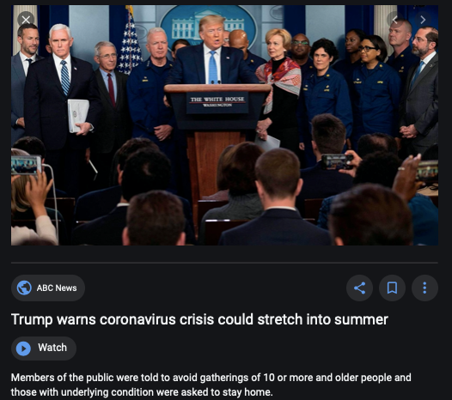
Coronavirus!

Slide 24
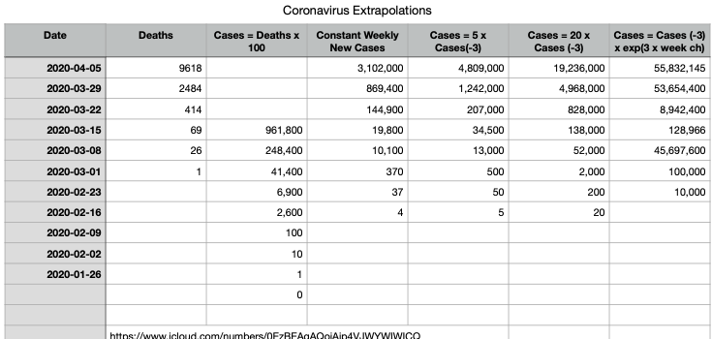
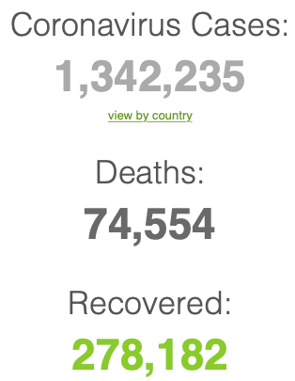
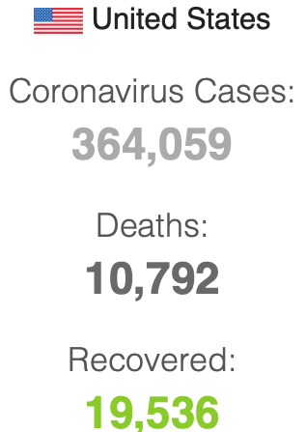

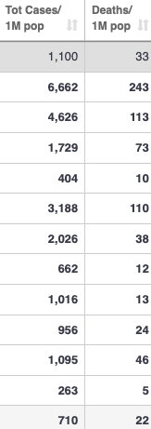
Coronavirus
Where we think we are, as of Mo Apr 6:
We really do not know
No random samples…
Best thing I have read comes from Jim Stock <https://drive.google.com/file/d/12MV466ZZy5xHir4xdPhoTrL1oO8CbZU-/view>:
The basic SIR epidemiological model of contagion
The effect of social distancing and business shutdowns on epidemic dynamics enters the model through a single parameter: the case transmission rate β
Re-express the model in terms of β and the asymptomatic (or not very symptomatic) hence non-tested rate—the fraction of the infected who are not tested
The COVID-19 non-testing rate is unidentified in our model
Estimates in the epidemiological literature range from 0.18 to 0.86.
The asymptomatic rate could be estimated accurately and quickly by testing a random sample
The optimal policy response and its economic consequences hinge critically on the asymptomatic rate

Slide 25
Where we think we are, as of Mo Apr 6:
We really do not know
No random samples…
Best thing I have read comes from Jim Stock <https://drive.google.com/file/d/12MV466ZZy5xHir4xdPhoTrL1oO8CbZU-/view>:
The basic SIR epidemiological model of contagion
The effect of social distancing and business shutdowns on epidemic dynamics enters the model through a single parameter: the case transmission rate β
Re-express the model in terms of β and the asymptomatic (or not very symptomatic) hence non-tested rate—the fraction of the infected who are not tested
The COVID-19 non-testing rate is unidentified in our model
Estimates in the epidemiological literature range from 0.18 to 0.86.
The asymptomatic rate could be estimated accurately and quickly by testing a random sample
The optimal policy response and its economic consequences hinge critically on the asymptomatic rate

Slide 29

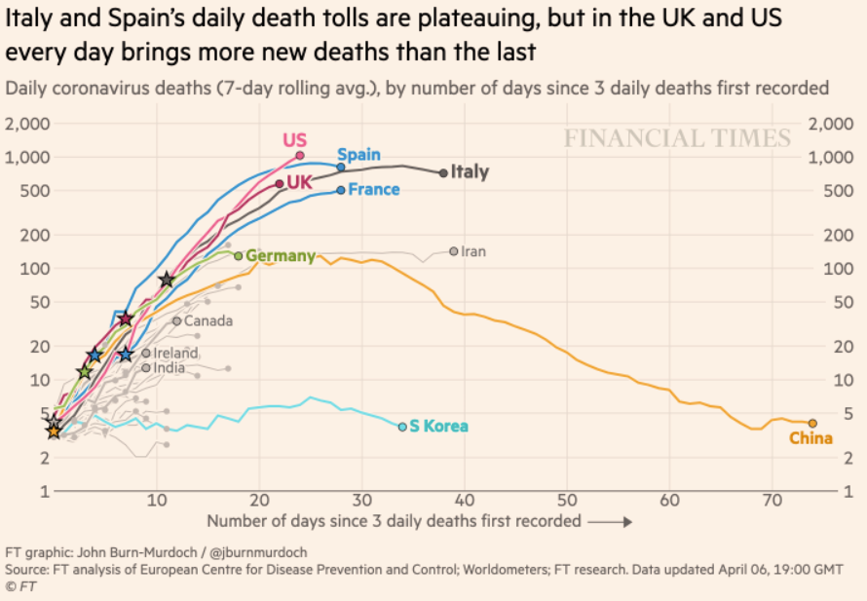
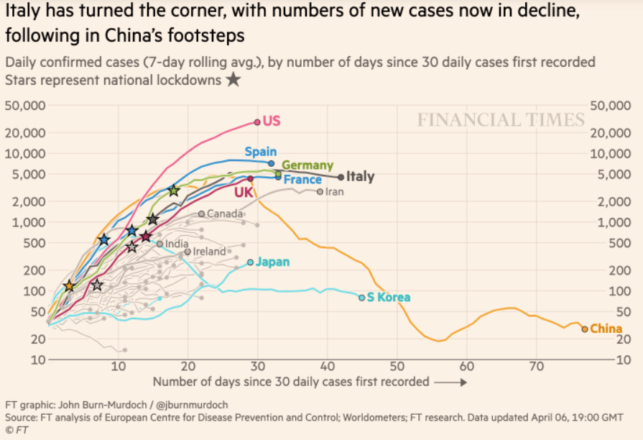
Financial Times Graphs Blown Up…

Slide 33
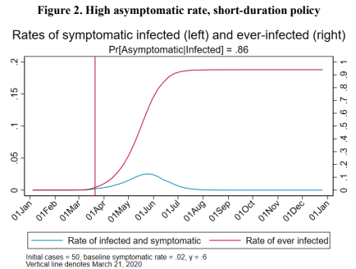
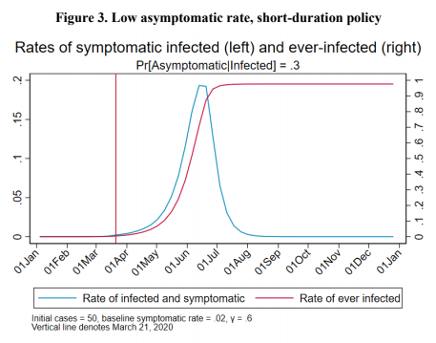
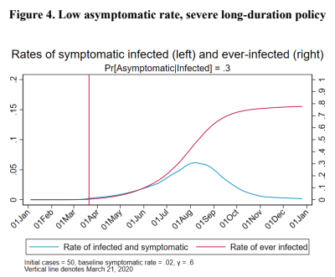
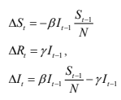
James Stock (2020)
Standard SIR model:<https://drive.google.com/file/d/12MV466ZZy5xHir4xdPhoTrL1oO8CbZU-/view>:
Susceptible, Infected, Recovered (& immune), transmission rate β, recovery rate γ, reproduction number R0, asymptomatic hence non-tested rate π0
Calibration: half-life of infection one week: γ = 0.5, s0 = 0.02, 50 cases on Jan 24
For March 21, 2020, the positive test rate in the United States is approximately 10%…
<https://drive.google.com/file/d/12MV466ZZy5xHir4xdPhoTrL1oO8CbZU-/view>

Slide 38
Bringing the Economy Back Up from Anæsthesia
Major issues:
Certificates of immunity:
Which requires test, test, test:
And not just disease virus tests
Presence-of-antibodies tests
How quickly can we match the immune with public-contact jobs?
What jobs can be done with minimal infection risk?
What minimal-infection substitutes can we find for previous jobs?
How quickly can restrictions be relaxed without the virus coming roaring back?
How do we avoid having the market give a “shutdown” signal to enterprises we in fact want restarted?
Which is pretty much all of them
How much of the potential caseload do we want to push out beyond the vaccine-arrival date?
ALL THESE QUESTIONS ARE ANSWERABLE IF WE LEARN THE ASYMPTOMATIC HENCE NON-TESTED RATE!!

Slide 39
Keeping the Economy from Crashing During the Lockdown
Nick Rowe: We have a 50% output cut in 100% of the sectors:
A temporary 100% output cut in 50% of the sectors (what the Coronavirus does) is very different from a 50% output cut in 100% of the sectors
Nick’s thought experiment:
In three months we are going to invent unobtanium:
Substantial intertemporal substitutibility
Plus lower cross-good contemporaneous substitutitbility
Hence high desired savings rate now
Flex-price market thus produces a nominal rate at the zero lower bound and a high inflation rate over the next three to six months
Plus liquidity-constrained workers in affected sectors see their demand go to zero immediately
Can we get there? Should we get there? What should we do instead?
We need a good RBC economist: are there any?…
<https://worthwhile.typepad.com/worthwhile_canadian_initi/2020/03/relative-supply-shocks-unobtainium-walras-law-and-the-coronavirus.html>

Slide 40
Keeping the Economy from Crashing During the Lockdown II
Nick Rowe <https://worthwhile.typepad.com/worthwhile_canadian_initi/2020/03/relative-supply-shocks-unobtainium-walras-law-and-the-coronavirus.html>:
Plus: to extend the thought experiment:
We just lost the ability to make “unobtainium”
So we should be substituting leisure for work, and moving workers into relatively unproductive labor, making the commodities we can still produce right now
How should relative prices move as a result? How should we make them move?
Plus: distributional issues
Plus: bankruptcy and credit chain issues

Slide 41
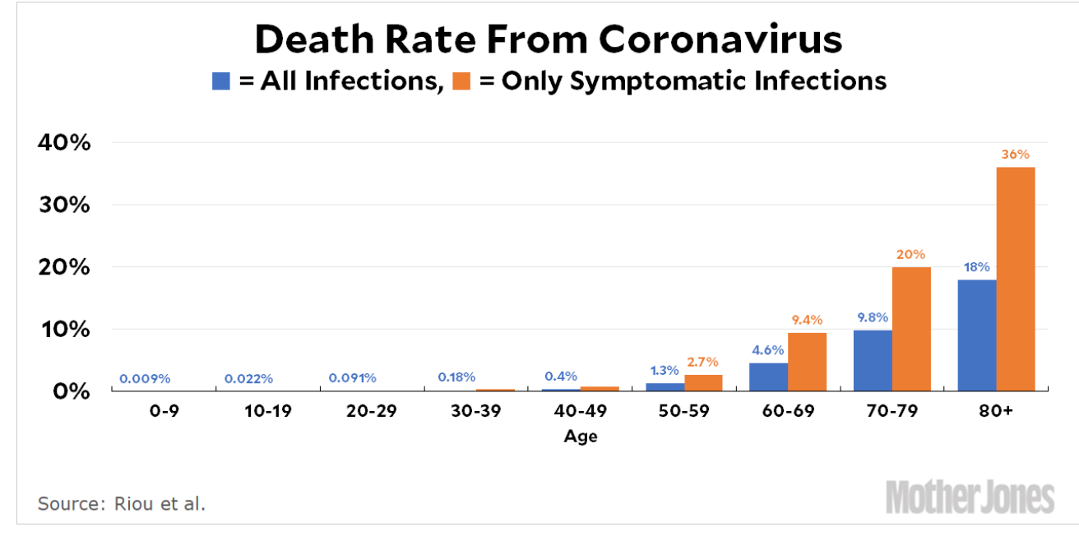
MOAR Coronavirus!
Death for Geezers!
Mortality for the Youngs very low…
It’s the flu for them—for you…
And an extra doubling—or is it 5%?—mortality for the asthmatic
And an extra doubling—or is it 5%?—mortality for the overweight

Slide 42
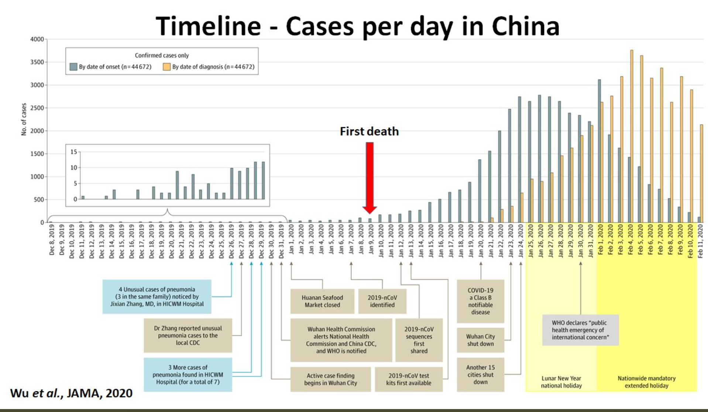
What We Think Happened in Wuhan
China beat it quickly & relatively easily!
We think
Shut down Wuhan when 200 cases per day
That seems to have been a good decision

Slide 43

The Goal
When Is It Appropriate to Move on This?
Immediate social distancing…
Self-isolate if you have a cough and a fever…
Hope that warmer temperatures will do to this what they did to SARS…
Otherwise, when do you want to start spreading out transmission. It seems that early is as good as later, so do it early…
I have no good intuition on why you want to move early
Plus your moving early will be wasted if you get reinfected
Plus the sparks you throw off making others’ lives more difficult

Slide 44
References
Financial Times (2020): Coronavirus Tracked: The Latest Figures as the Pandemic Spreads <https://www.ft.com/coronavirus-latest>
Nick Rowe (2020): Relative Supply Shocks, Unobtainium, Walras' Law, and the Coronavirus <https://worthwhile.typepad.com/worthwhile_canadian_initi/2020/03/relative-supply-shocks-unobtainium-walras-law-and-the-coronavirus.html>
Jim Stock (2020): Coronavirus Data Gaps and the Policy Response <https://drive.google.com/file/d/12MV466ZZy5xHir4xdPhoTrL1oO8CbZU-/view>

Slide 45
MOAR Coronavirus!
What I am watching:
Max Roser & Hannah Ritchie: Coronavirus Disease (COVID-19) <https://ourworldindata.org/coronavirus>…
Worldometer: Coronavirus Update (Live) <https://www.worldometers.info/coronavirus/>: ‘125,599 Cases and 4,605 Deaths from COVID-19 Virus Outbreak…
FT Coronavirus Tracker <https://www.ft.com/content/a26fbf7e-48f8-11ea-aeb3-955839e06441>
Josh Marshall’s COVID Twitter List <https://twitter.com/i/lists/1233998285779632128>
NEJM Group: Updates on the Covid-19 Pandemic <http://m.n.nejm.org/nl/jsp/m.jsp?c=%40kxNtXckRDOq8oG0jJvAXsIzN4mPECIPhltxoTSdTU9k%3D&cid=DM89089_NEJM_COVID-19_Newsletter&bid=173498255>: 'From the New England Journal of Medicine, NEJM Journal Watch, NEJM Catalyst, and other trusted sources...

Slide 46
Catch Our Breath…
Ask a couple of questions?
Make a couple of comments?
Any more readings to recommend?
<https://www.icloud.com/keynote/0YKEi7HeOrVGvKYtt9FEqH7nA>

Slide 47
Coronavirus! (March 16)
With 31 deaths in the U.S. as of March 11, a 1% death rate, and up to 4 weeks between infection and death, that means that as of Feb 12 there were 3100 coronavirus cases in the United States.
With 87 deaths in the U.S. as of Mar 16, a 1% death rate, and up to 4 weeks between infection and death, that means that as of Feb 17 there were 8700 coronavirus cases in the United States
If it is doubling every seven days, then now about 150,000 people have and in the next week about 150,000 more people in the U.S. will catch coronavirus—which means 1/2200, currently 3500 of the 7.6 million inhabitants of San Francisco Bay. Touch a hard surface that any of those 3500 has touched in the last 48 hours, and the virus has a chance to jump to you…
These numbers could be five times too big. These numbers are probably not five times too small unless the thing is a lot less deadly, and there are a lot of asymptomatic cases…
What is wrong with this analysis?

Slide 48

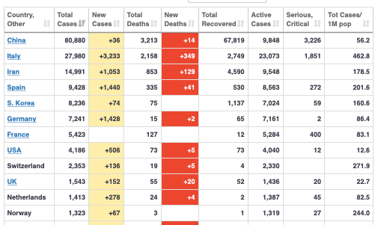
MOAR Coronavirus!
As of March 21: Things are not moving in the right direction:
What is the R0?
How can the R0 be changed?
How will the R0 change?
What is the asymptote share of the population?
What is the mortality rate?

Slide 49

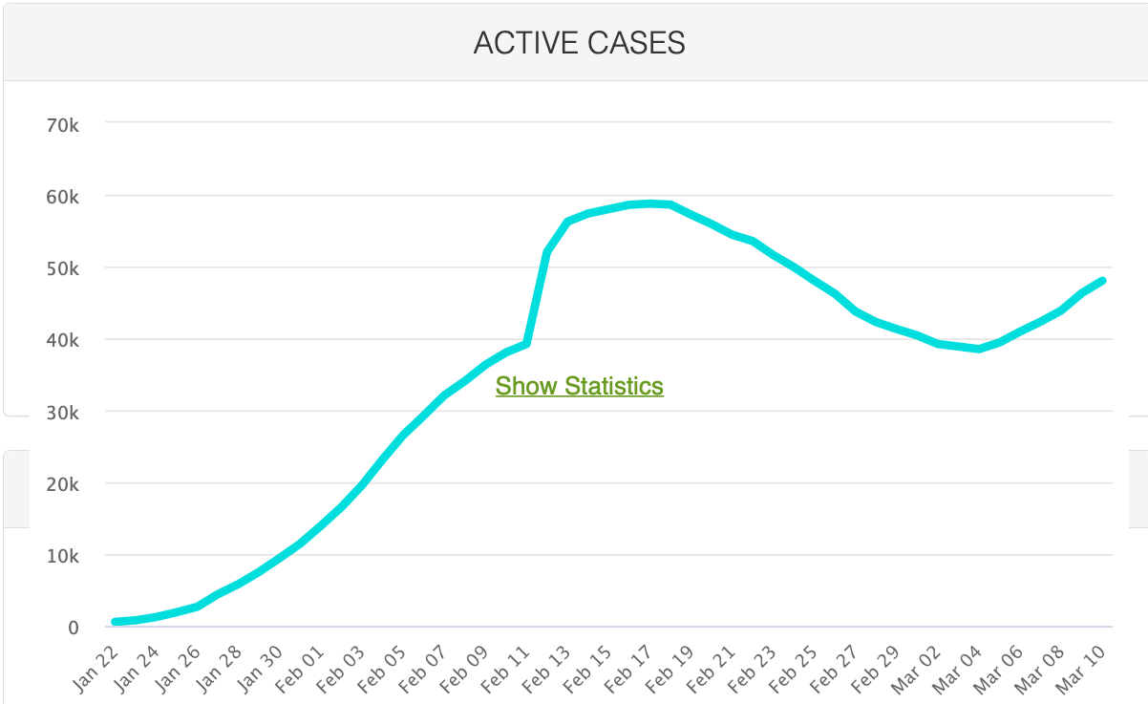
MOAR Coronavirus!
As of March 10: Things are not moving in the right direction:
What is the R0?
How can the R0 be changed?
How will the R0 change?
What is the asymptote share of the population?
What is the mortality rate?

Slide 50
Notes

